Slide 1
Externally Mounted Composite Radome / Fairings for Special Mission Applications
FAA Workshop on Modifications and Alterations affecting Composite Parts or Composite Structure
July 19-20, 2016

Slide 3
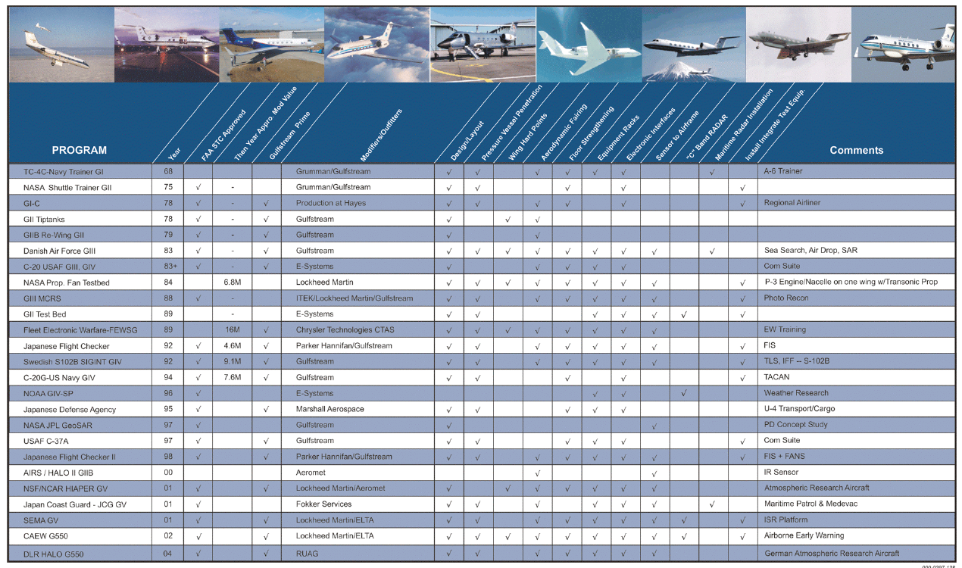
Gulfstream Special Mission Experience

Slide 4
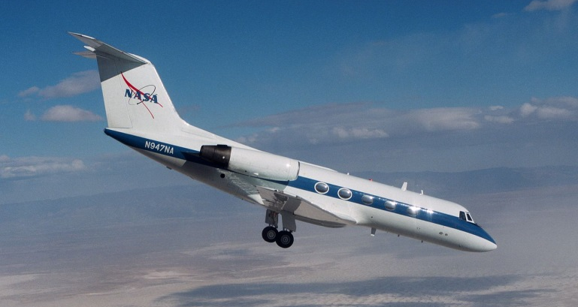
Gulfstream Special Mission Experience
GI
TC-4C A-6 Trainer
GII/GIIB
NASA Shuttle Trainer
US Military Research Testbed

Slide 5
Gulfstream Special Mission Experience
GIII
Foreign Military Cargo Door Installation
GIV / G450
US Military Cargo Door Installation
Foreign Military Signal Intelligence
Gov VIP Transport

Slide 6
Gulfstream’s Experience - Special Missions
GV / G550
Foreign Military Signal Intelligence
Foreign Military Tracking / Surveillance
Domestic / Foreign Atmospheric Research Platforms
Gov VIP Transport

Slide 7
Gulfstream’s Experience – Special Missions
Types of Special Mission Modifications / Installations
Nose Radome
Forward Fuselage Belly Radome (Canoe)
Forward Fuselage Upper Fairings
Forward Fuselage Side Fairings
Aft Fuselage Lower Fairing
Empennage Tip Cap Radome
Tailcone / Ventral Fin
Wing Stores

Slide 8
Gulfstream’s Experience – Special Missions
Each Modification has its own unique design challenges
All radome / fairing modifications require composite material of some type
Transmissivity
Weight
Stiffness
Complex Contours

Slide 9
Gulfstream’s Experience – Special Missions
Most Challenging are Fuselage Belly Radomes or ‘Canoes’
Largest
Most Complex due to -
Mission / Customer Requirements
Aircraft Requirements
Regulatory Requirements

Slide 10
Radome Structural Design Criteria
Customer Driven Requirements
Transmissivity
Field of View
Maintenance Access
Aircraft Driven Requirements
Aerodynamic Loading
Flight Envelope / Mission Profile
Structural Loading
Airframe Deflection
Forced Deflection

Slide 11
Radome Structural Design Criteria
Selected Regulatory Requirements
Design and Construction
25.601 General
25.603 Materials
25.605 Fabrication Methods
25.609 Protection of Structure
25.613 Material Strength Properties and Material Design Values
Structure
25.301 Loads
25.303 Factor of Safety
25.305 Strength and Deformation
25.307 Proof of Structure

Slide 12
Radome Structural Design Criteria
Selected Regulatory Requirements
Structure - Continued
25.365(e) Pressurized Compartment Loads
25.571 Damage Tolerance
Fatigue Assessement
Parts Departing Aircraft
Birdstrike – section 25.571(e)(1)
25.581 Direct Effects of Lightning

Slide 13
Radome Structural Design Criteria
Policy Statement
PS-ACE100-2004-10030 Substantiation of Secondary Composite Structures
PS-ANM-25-17 Structural Certification Criteria for Antennas, Radomes, and Other External Modifications
Advisory Material
AC 20-107B Composite Aircraft Structure

Slide 14
Radome Structural Design Criteria
Company / Customer Criteria
Structures not tested to ultimate loads should maintain min. M.S. = 0.25
If tested, min would be M.S.= 0.00
Ref. MIL-HDBK-516C
Aero Pressure loads to have ultimate load factor of 2.0
May reduce to 1.5 based on previous tests
Belly pod sizing based on external pressure loads and inertia loading
Inertia to include emergency landing and flight inertial

Slide 15
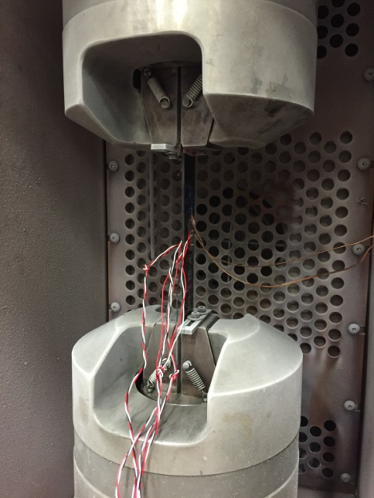
25.603 Material 25.613 Material Design Values
Material
Typically fiberglass or quartz fiber
Required for transmissivity characteristics
Graphite/Epoxy for non transmission locations

Slide 16
25.603 Material 25.613 Material Design Values
Previous Programs
Fiberglass material used throughout components
Other radomes / fairings
Material testing implemented to validate material data
Strength
Modulus
Strain Cutoffs
Critical Environmental Conditions

Slide 17
25.603 Material 25.613 Material Design Values
Current / Future Programs
More sophisticated equipment requiring more advanced material
Testing programs developed to generate next generation of design values
Material Equivalency testing to existing material databases
Extensive use of NIAR facilites/capabilities

Slide 18
25.605 Fabrication
Radome / Canoe Fabrication
Panels / Shell
Solid Laminate or Honeycomb Sandwich
Mission Dependent
Fabrication Processes
Well Understood
Neither new nor novel
In house fabrication process specifications
Previously approved

Slide 19
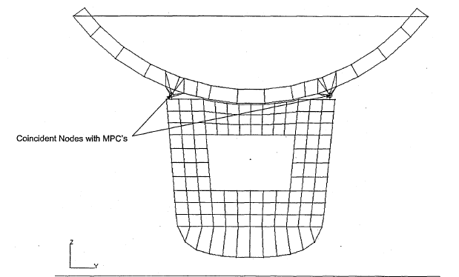
25.305 Proof of Structure 25.307 Strength and Deformation
Both classical analysis and FEM are employed.
Laminates are analyzed by typical laminate sizing routines
Strain cutoffs
Buckling criteria
FEM Model validation
Unit loading / classical solutions
Constraints Checks
Deflection Checks
Boundary Conditions

Slide 20
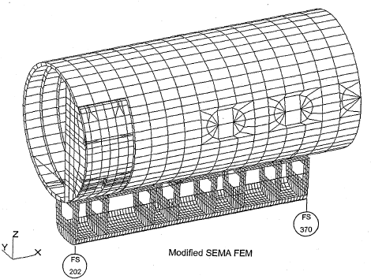
25.305 Proof of Structure 25.307 Strength and Deformation
Maintain minimum M.S. for untested structure
Customer / company requirement
Testing performed to validate analysis and analytical details
Fuselage Proof Pressure
Attachment fittings

Slide 21
25.365(e) – Pressurized Compartment Loads
Belly pods are not pressurized but are attached to pressurized fuselage
Requirement per 25.365(e) requires any structure outside a pressurized compartment to be able to withstand the sudden release of pressure from fuselage
Belly pods designs incorporate means of venting the radome in a fuselage decompression event.

Slide 22
25.571 Damage Tolerance
Fatigue Assessment
Influence of Canoe / Belly Pod Radome on aircraft fatigue life is addressed
Affected sections of airframe are reviewed and updated if required
Parts Departing Aircraft
Fuselage Canoe / Belly pod radomes
All designs have multiple attachments at frame locations
Design incorporates ability to lose connections
‘Get Home’ loading

Slide 23
25.571 Damage Tolerance
Inspections are established
Radome laminate
Fittings attaching radome to fuselage
Impact damage of composite shell

Slide 24
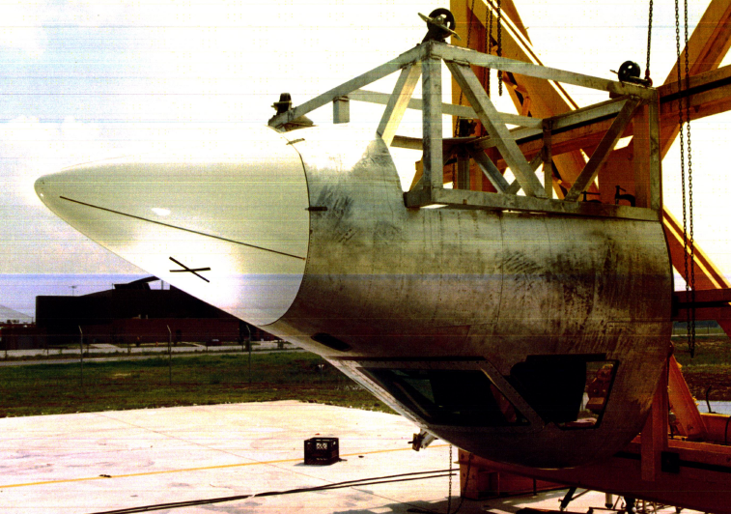
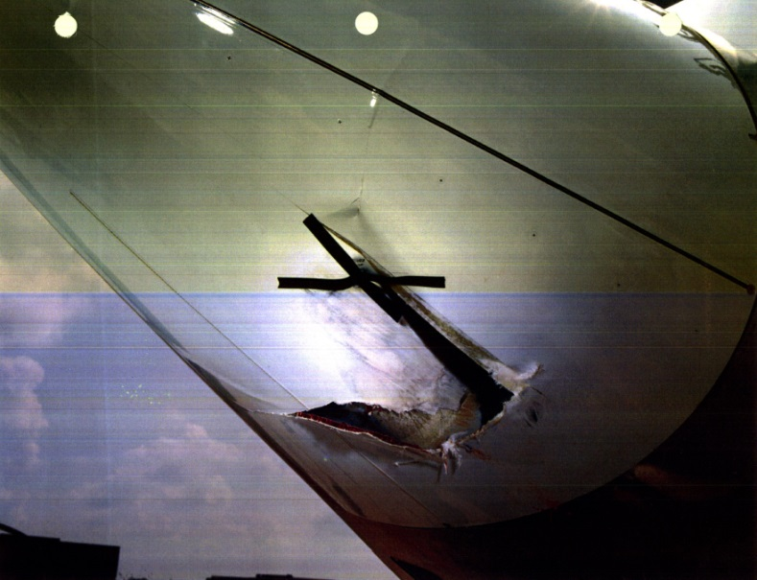
25.571(e) - Birdstrike
Previous Programs
Birdstrike testing performed
Bird will penetrate radome
Bird disintegrates on impact
Composite fiber toughness
shreds the bird
No parts separated from test article
Assessment of penetration
Ram air effect due to hole
Full aerodynamic pressurization
Multiple fitting design

Slide 25
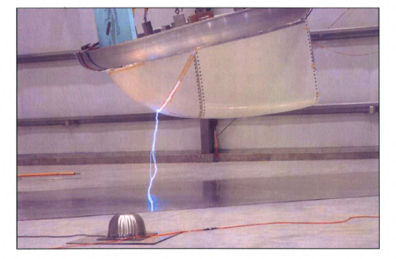
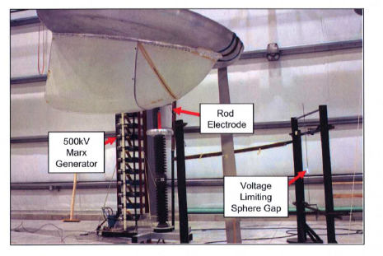
25.581 – Direct Effects of Lightning
Belly Pod Radomes are generally located in primary strike zone locations
Segmented diverters are typically utilized
Leading edges/extremities
Mesh in acreage not in FOV
Testing
High voltage determines attachment location
High current validates protection strategy

Slide 26
Summary
Composite Belly Pod / Canoe Radome designs have been in service on Gulfstream aircraft for over 25 years
Fiberglass / Graphite Composite material utilized throughout all designs
Successful Implementation based on
Conservative design criteria
Sound material selection
Proven fabrication methods
Reliable structural analysis techniques
Systematic inspection

Slide 27
Questions?

